Slide 1

SESHADRI RAO GUDLAVALLERU ENGINEERING COLLEGE DEPARTMENT OF INFORMATION TECHNOLOGY
INTERNSHIP REVIEW
ON
MACHINE LEARNING AND DEEP LEARNING
Under the guidance of
Sri.Ch.Venkateswara Rao.,M.Tech
By
MAJJI PAVAN KUMAR
(19481A1264)

Slide 2
CONTENTS
INTRODUCTION TO MACHINE LEARNING AND PYTHON
PYTHON FOR DATA SCIENCE
PROJECT ON MACHINE LEARNING AND DEEP LEARNING

Slide 3
INTRODUCTION TO MACHINE LEARNING AND PYTHON
Machine Learning (ML) is a branch of Artificial Intelligence (AI) that enables computers to “self-learn” from training data and improve over time, without being explicitly programmed.
Machine Learning Algorithms are able to detect patterns in data and learn from them, in order to make their own predictions.
Machine Learning, on the other hand, is an automated process that enables machines to solve problems with little or no human input, and take actions based on past observations.
Basically for Machine Learning we use Jupyter Notebook to write a code.

Slide 4
WHAT IS PYTHON
Python is a popular programming language.
It is used for:
web development (server-side)
software development
mathematics
system scripting

Slide 5
PYTHON FOR DATA SCIENCE
Data science is an interdisciplinary field that uses scientific methods, processes, algorithms and systems to extract or extrapolate knowledge and insights from noisy, structured and unstructured data and apply knowledge from data across a broad range of application domains.
The milestone allows you to work with python data science modules like
Numpy
Pandas
Matplotlib
Seaborn
for data Analysis.
Data Visualization is the process of presenting data in the form of graphs or charts. It helps to understand large and complex amounts of data very easily.

Slide 6
PROJECT ON MACHINE LEARNING AND DEEP LEARNING
Project on
“Detecting Parkinson’s Disease Using IBM Watson”

Slide 7
Detecting Parkinson’s Disease Using IBM Watson
According to the Parkinson’s Foundation in worldwide more than 10 million people are suffering from Parkinson’s Disease. While Parkinson’s cannot be cured, early detection along with proper medication can significantly improve symptoms and quality of life. The researchers found that the drawing speed was slower and the pen pressure is lower among Parkinson’s patients. One of the main indications of Parkinson’s is tremors and rigidity in the muscles, it will make difficult to draw smooth spirals and waves. According to the researchers It is possible to detect Parkinson’s disease using the drawings alone instead of measuring the speed and pressure of the pen on paper. Our main goal is to quantify the visual appearance using HOG method of these drawings written by the persons and then train a machine learning model to classify these drawings. In this model, we are using, Histogram of Oriented Gradients (HOG) image descriptor along with a Random Forest classifier to automatically detect the Parkinson’s disease using hand-drawn images of spirals and waves form drawings

Slide 8
Project Objectives
You’ll be able to understand the problem to classify if it is a regression or a classification kind of problem.
You will be able to know how to pre-process the image by using different data pre-processing techniques.
you will learn how to use OpenCV and machine learning to automatically detect Parkinson’s disease in hand-drawn images of spirals and waves
You will be able to know how to find the accuracy of the model.
You will be able to Build web applications using the Flask framework.

Slide 9
Services used
IBM Watson Studio
IBM Watson Machine Learning
Node-RED
IBM Cloud Object Storage

Slide 10
Project description
More than 10 million people are living with Parkinson’s Disease worldwide, according to the Parkinson’s Foundation. While Parkinson’s cannot be cured, early detection along with proper medication can significantly improve symptoms and quality of life
The researchers found that the drawing speed was slower and the pen pressure is lower among Parkinson’s patients. One of the indications of Parkinson’s is tremors and rigidity in the muscles, making it difficult to draw smooth spirals and waves. It is possible to detect Parkinson’s disease using the drawings alone instead of measuring the speed and pressure of the pen on paper. Our goal is to quantify the visual appearance(using HOG method) of these drawings and then train a machine learning model to classify them. In this project, We are using, Histogram of Oriented Gradients (HOG) image descriptor along with a Random Forest classifier to automatically detect Parkinson’s disease in hand-drawn images of spirals and waves.

Slide 11
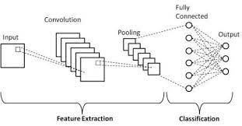
Technical Architecture

Slide 12
Technical Architecture
Creates an IBM Watson studio service on IBM Cloud.
Creates an IBM cloud object storage service and adds that to Watson Studio.
Uploads the insurance premium data file into Watson Studio.
Creates an AutoAI experiment to predict insurance premium on Watson Studio.
AutoAI uses Watson Machine Learning to create several models, and the user deploys the best performing model.
The user uses the flask web-application to connect to the deployed model and predict an insurance charge.

Slide 13
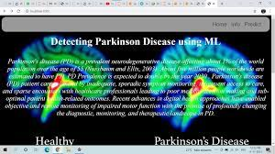
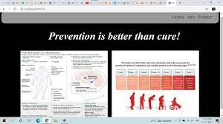
OUTPUT
Figure 1: Home page of the model
Figure 2: Information page

Slide 14
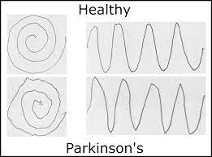
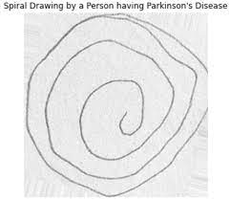
OUTPUT
Figure 3: Predicting spiral image of healthy person.
Figure 4: Predicting spiral image of disease person.

Slide 15
Advantages and disadvantages
Advantages:
Easy to implement
Easy to train
Disadvantages:
Long training process
Hard to implement

Slide 16
Thank you

